Slide 1
DBMS Implementation project Part III
Pooja Nalan & Utsav Raychaudhuri

Slide 2
Postgres
It is a powerful, open-source object relational database that extends SQL language.
Robust feature set, extensible and consistent delivery of performance and runs on major operating systems.
It has many features that help developers build fault tolerant environment and manage data no matter how big.

Slide 3




Why Postgres?
Familiarity with the system and ease of use
Easier to compare differences in the performance within a system and test various features
Lots of resources and community threads to learn from.
Various query parameters can be tweaked and observed for variations in performance.

Slide 4
Goals
Using the Wisconsin benchmark design to generate data tables of various sizes and perform various experiments on them. Our code generates data according to the Wisconsin benchmark specification, as described in “The Wisconsin Benchmark: Past, Present, and Future” by David J. DeWitt
Test the performance of the system by choosing a variety of queries fetching data of different size and attributes under varying conditions.
Observe and record the results of execution and measure the performance in terms of time and cost and the impact of modifying query parameters.

Slide 5

Experiment 1
Performance issue :
work_mem specifies the amount of memory used by internal sort operations and hash tables before writing to temporary disk files.There could be a difference in the performance when the work_mem is increased or decreased based on the no of connections and also the sort operation performed on the relations.
Parameters :
Vary work_mem upto 128 MB.

Slide 6
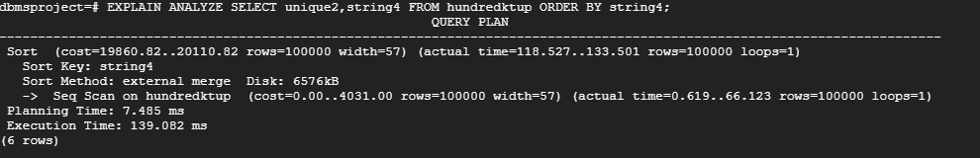
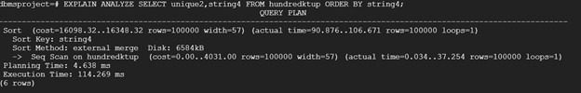
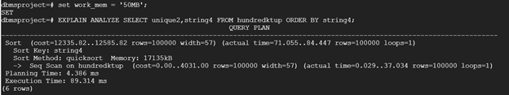
Execution
Query: EXPLAIN ANALYZE SELECT unique2,string4 FROM hundredktup ORDER BY string4;
work_mem = ‘500kB’
work_mem = ‘4MB’
work_mem = ‘50MB’

Slide 7
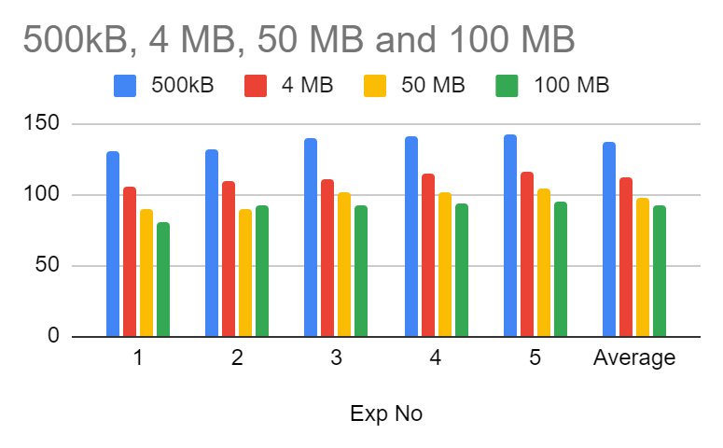
Results of Execution
Exp No | Execution time for work_mem (milli seconds)
 | 500kB | 4 MB | 50 MB | 100 MB
1 | 129.75 | 105.241 | 89.314 | 80.605
2 | 131.942 | 109.163 | 89.793 | 91.961
3 | 139.082 | 110.789 | 100.925 | 91.966
4 | 140.871 | 114.269 | 101.712 | 93.065
5 | 142.714 | 116.323 | 103.514 | 94.113
Average | 137.298 | 111.407 | 97.476 | 92.330

Slide 8
Results
The size of the relation hundredktup is 46MB. Since the size of the relation is larger than work_mem which is 4MB by default, the database had to use external merge sort to sort the relation.
Now changing the work_mem to 50 MB and then 100 MB decreases the execution, the database uses quicksort which reduces the execution time from 111.407 to 92.330
Increasing work_mem doesn’t always improve the performance. A database backs a web server, and, in that case, you have many queries coming through the web service and too many hitting at the same time. To not overwhelm the memory, we want those different queries to get a small bit of memory. We want work mem to be relatively small to allow many queries and to allocate some amount of space to each query.

Slide 9
Experiment 2
Performance Issue: This experiment explores the benefit of setting the random_page_cost parameter on the performance of queries.
What is random_page_cost and what does it do?
Sets the planner's estimate of the cost of a non-sequentially-fetched disk page. The default is 4.0. This value can be overridden for tables and indexes in a particular tablespace by setting the tablespace parameter of the same name.Reducing this value relative to seq_page_cost will cause the system to prefer index scans; raising it will make index scans look relatively more expensive. We can raise or lower both values together to change the importance of disk I/O costs relative to CPU costs

Slide 10
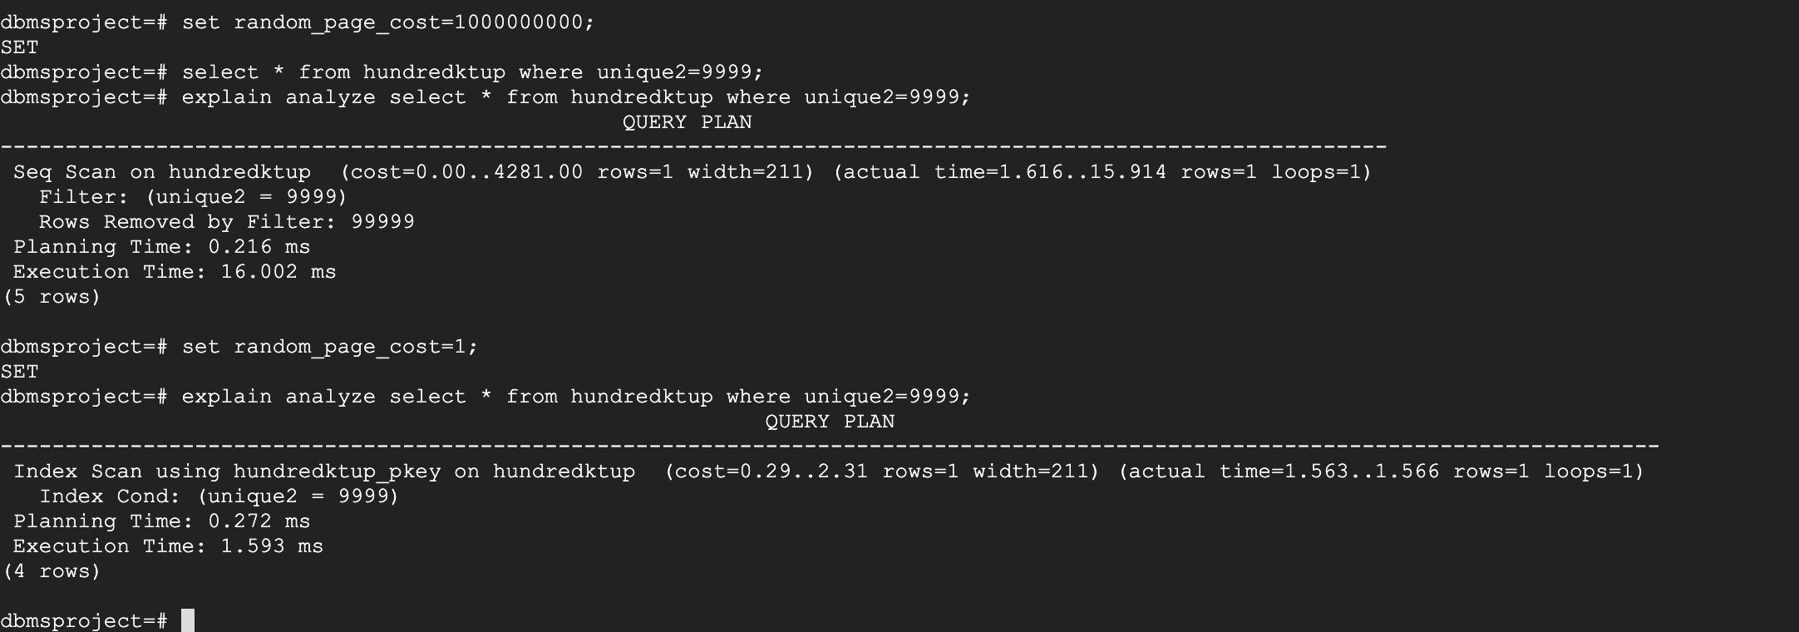
The Experiment

Slide 11
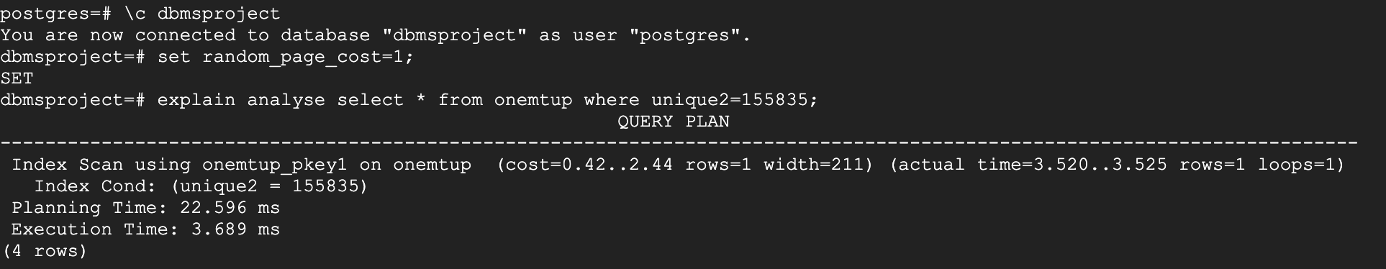
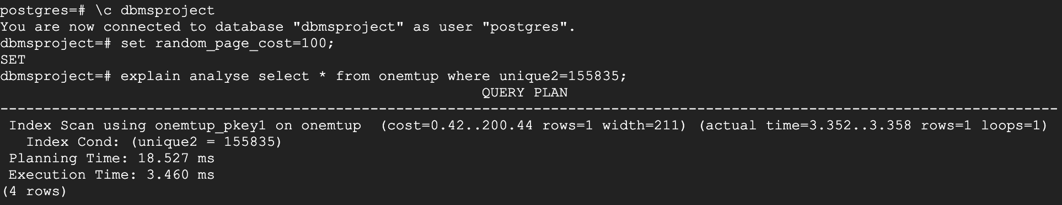
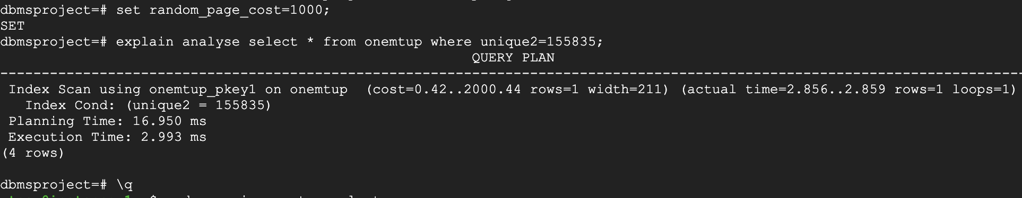
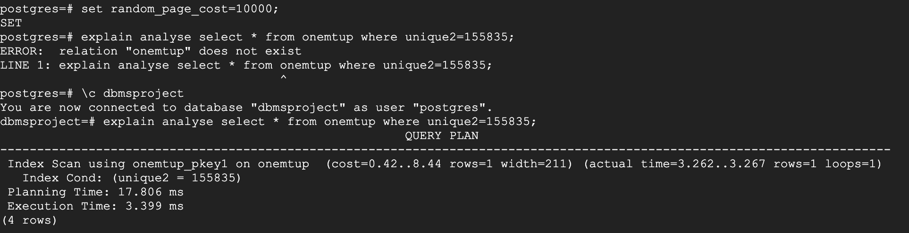
Result of Execution

Slide 12
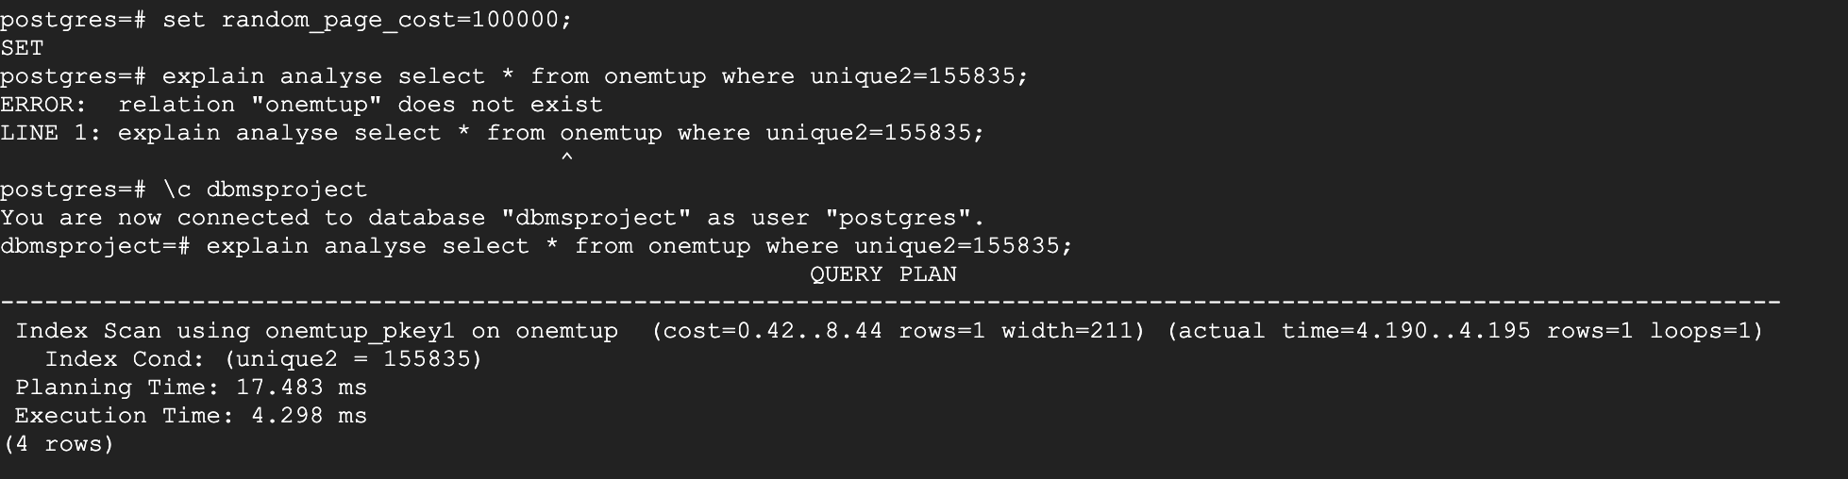
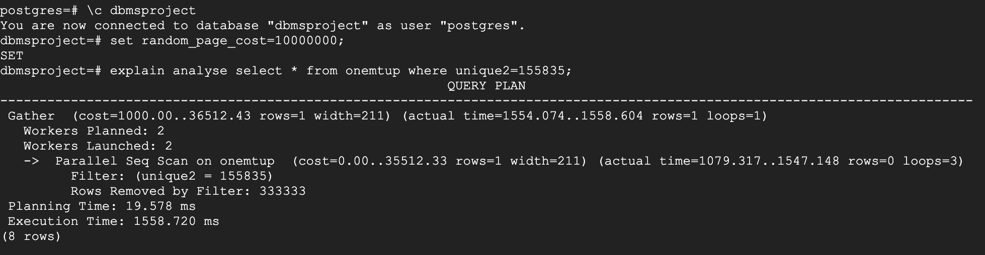
Result of Execution(Continued)

Slide 13
Results
We saw 16 times improvement in performance by reducing the value of random_page_cost. So, what this parameter does is by setting this value higher the query optimizer thinks that a sequential scan is better than an index scan which was the case in our experiment.
So, it would be good to set this to a lower value because by doing this the query optimizer prefers an index scan which took only 1 ms in our case to scan a 100000-tuple dataset.
Exp No. | random_page_cost | Execution time | Type of Scan Used
1 | 1 | 3.689 | Index
2 | 100 | 3.4 | Index
3 | 10000 | 3.4 | Index
4 | 100000 | 4.3 | Index
5 | 10000000 | 1558.72 | Sequential

Slide 14
Experiment 3
Performance issue:
This test explores how the query optimizer benefits from using a clustered index when compared to non-clustered index.
Parameters:
The parameter we would be using here is unique2 which is a clustered index and unique1 which is a non-clustered index.
Query Example 1: Clustered Index: EXPLAIN ANALYZE SELECT * FROM tenktup1, (SELECT * FROM tenktup2 WHERE tenktup2.unique2 < 1000) AS BPRIME WHERE (tenktup1.unique2 = BPRIME.unique2); Non-Clustered Index: EXPLAIN ANALYZE SELECT * FROM tenktup1, (SELECT * FROM tenktup2 WHERE tenktup2.unique1 < 1000) AS BPRIME WHERE (tenktup1.unique1 = BPRIME.unique1);

Slide 15
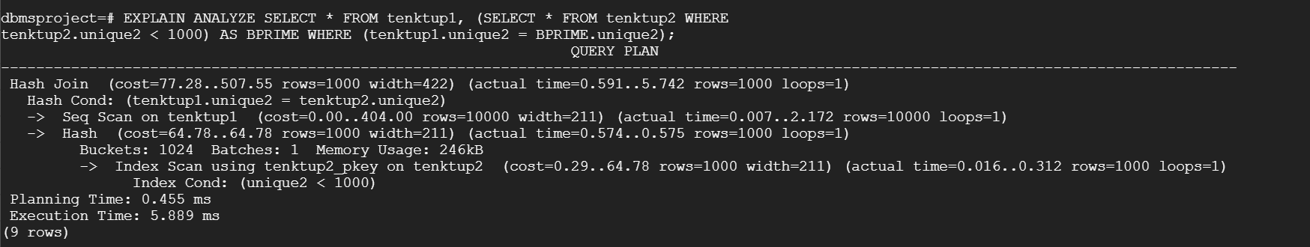
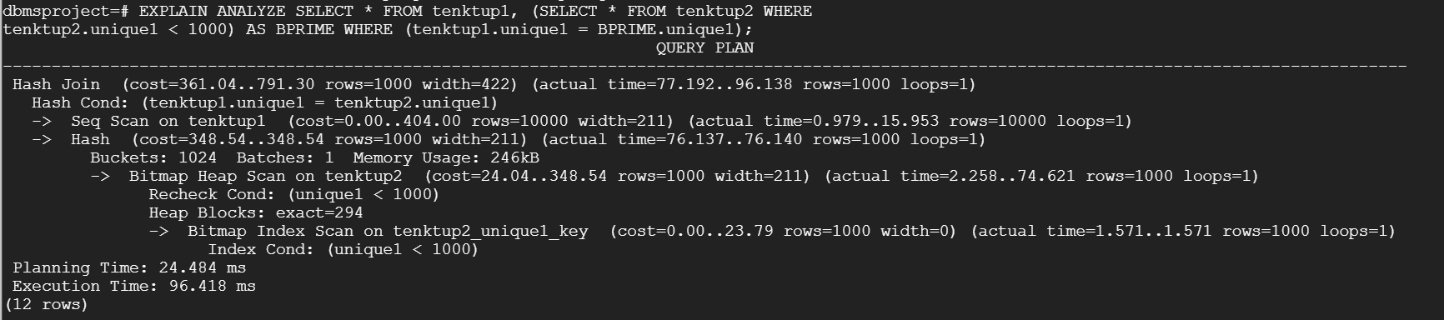
Execution Example 1

Slide 16
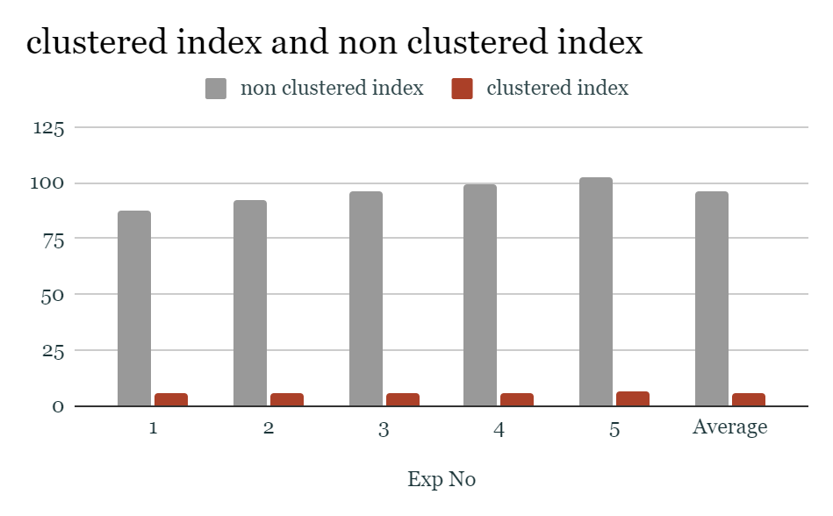
Result of Execution:
Exp No | Execution time (milli seconds)
 | non clustered index | clustered index
1 | 87.118 | 5.385
2 | 92.079 | 5.431
3 | 96.418 | 5.889
4 | 99.367 | 5.892
5 | 102.351 | 6.395
Average | 95.95466667 | 5.737333333

Slide 17
Query Example 2:
Clustered Index:
EXPLAIN ANALYZE SELECT * FROM onektup LEFT JOIN (tenktup1 JOIN tenktup2 ON (tenktup1.unique2 = tenktup2.unique2)) ON (onektup.unique2 = tenktup1.unique2) AND tenktup1.tenpercent = 9;
Non - Clustered Index:
EXPLAIN ANALYZE SELECT * FROM onektup LEFT JOIN (tenktup1 JOIN tenktup2 ON (tenktup1.unique1 = tenktup2.unique1)) ON (onektup.unique1 = tenktup1.unique1) AND tenktup1.tenpercent = 9;

Slide 18
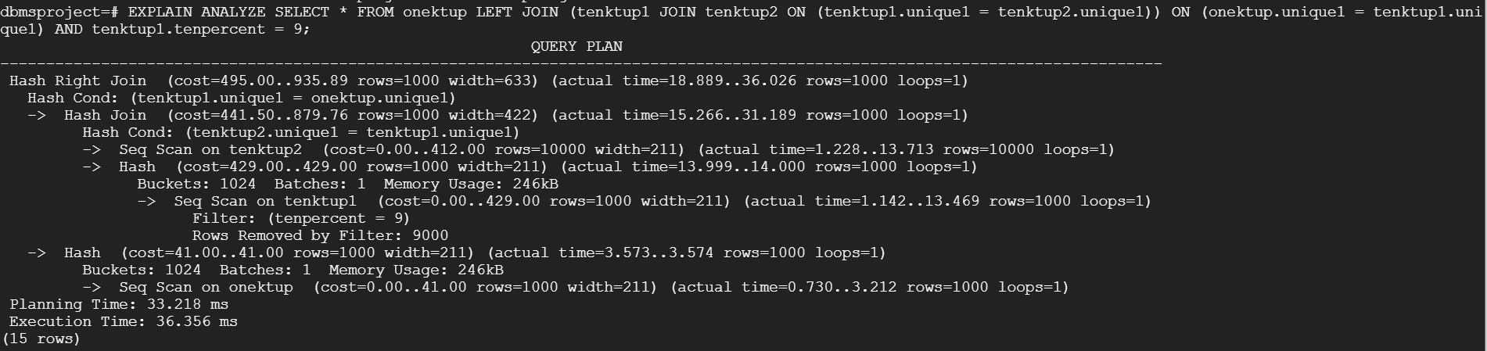
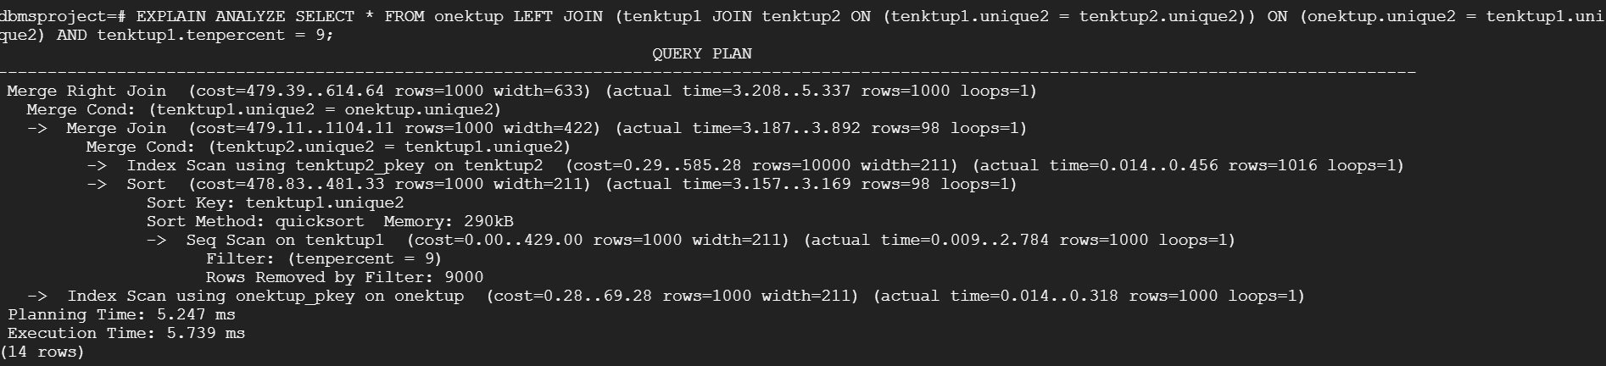
Execution Example 2:

Slide 19
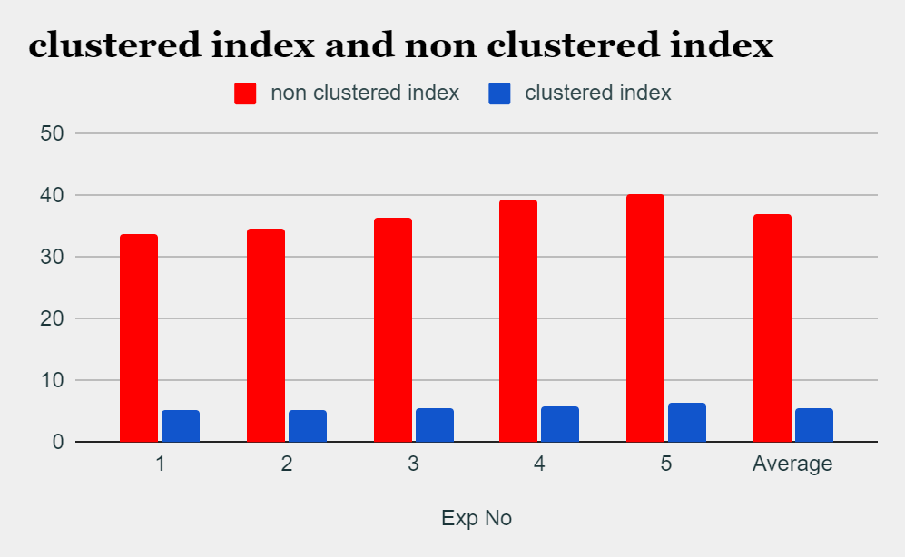
Results of Execution
Exp No | Execution time (milli seconds )
 | non clustered index | clustered index
1 | 33.862 | 5.221
2 | 34.76 | 5.27
3 | 36.356 | 5.526
4 | 39.443 | 5.739
5 | 40.331 | 6.395
Average | 36.853 | 5.511666667

Slide 20
Results
In clustered index the tuples in the table are sorted on the index and stored in memory. By default, the primary key of a table has a clustered index. Once an index search is done and found, pulling out the data on the same page is faster since we’ve already found the start point and it’s easier to point all successive data nearby.
Since, each record is found from index data, it needs to look in heap data which causes random I/O and it’s considered to perform slower than sequential I/O . If a small percentage of records are selected which is calculated based on the PostgreSQL optimizer cost, only then PostgreSQL chooses Index scan otherwise it continues to use sequence scan even though there is an index on the table.
We expect to see a higher execution time when we query a non clustered index when compared to using a clustered index. Even though index creation speeds up performance , it has to be chosen carefully as it has overhead in terms of storage and has many factors such as database structure, queries , etc.

Slide 21
Experiment 4
Performance Issue:
We analyze the impact of various join algorithms on the query execution time.
Data set:
The dataset we use here is a join on tenktup and onemtup which consists of ten thousand and one million records respectively.
Query:
In this query, we extract all the records of onemtup and tenktup on which a join operation is performed. All the records where tenktup’s unique2 values are lesser than 7000 are fetched and analyzed.
EXPLAIN ANALYZE SELECT * FROM tenktup1,onemtup WHERE onemtup.unique2 = tenktup1.unique2 AND onemtup.unique2<7000
We expect this to use a sort merge join and this should be faster because we already have a clustered index on unique2
SELECT * FROM hundredktup h1,hundredktup h2 WHERE h1.unique1 = h2.unique1 AND h1.unique1 BETWEEN 7000 AND 10000;
We expect this to use a hash join which should take more time than the sort merge join. It was very interesting to see this same query when executed on onemtup the query optimizer resorts to a nested loop join. The reason is still a little unclear to us.

Slide 22
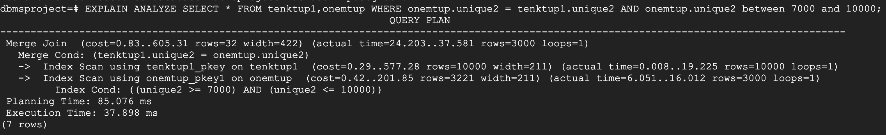
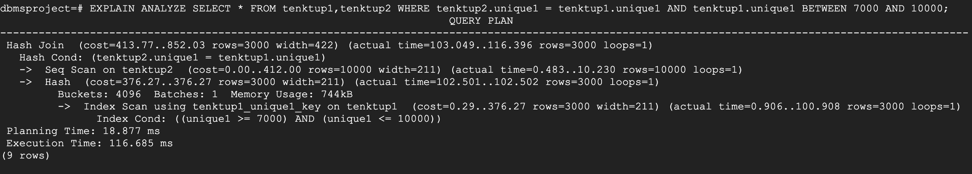
Execution
Sort Merge Join
Hash Join

Slide 23
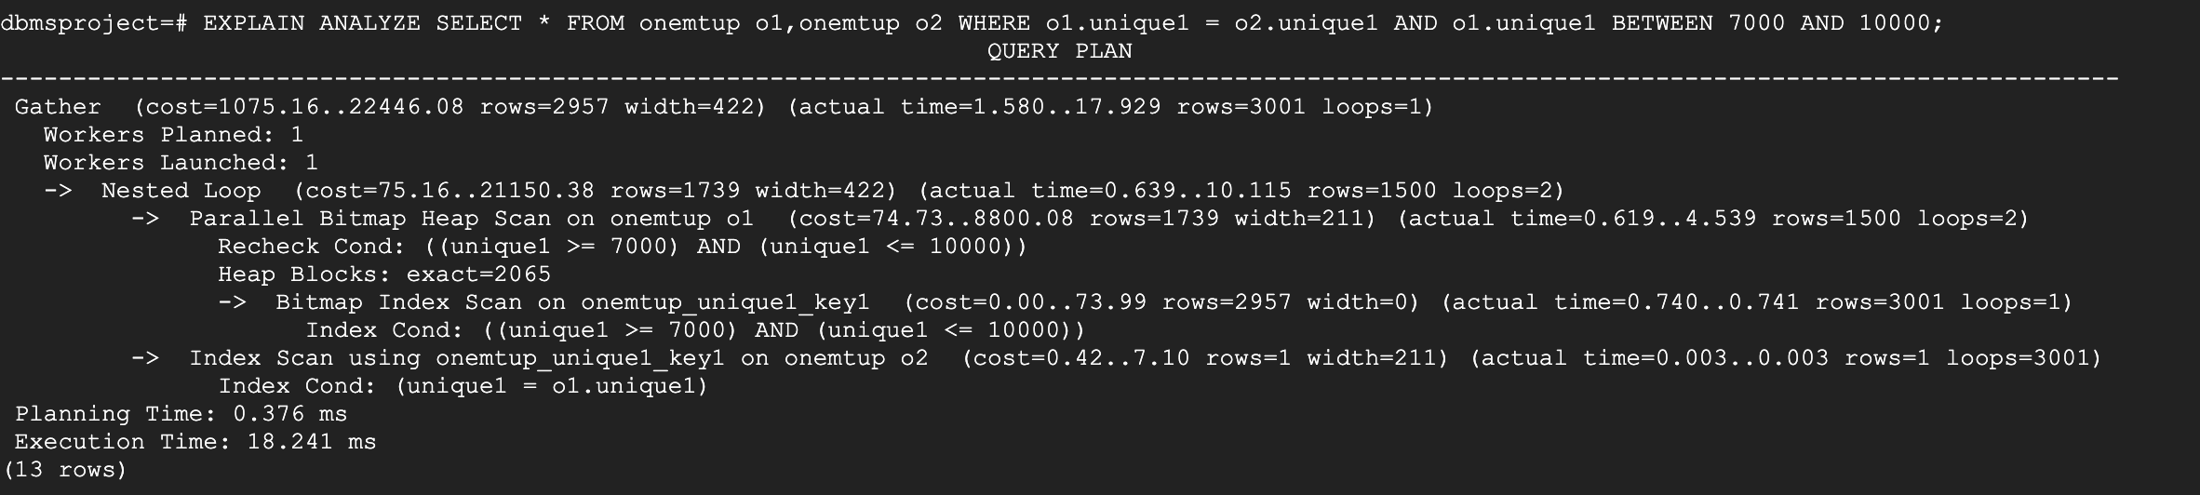
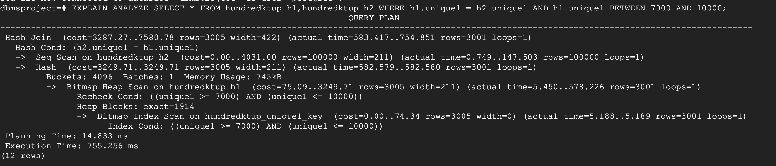
Execution
Nested Loop Join
Hash Join(Same query different Table but different Join Algorithm )- Interesting??

Slide 24
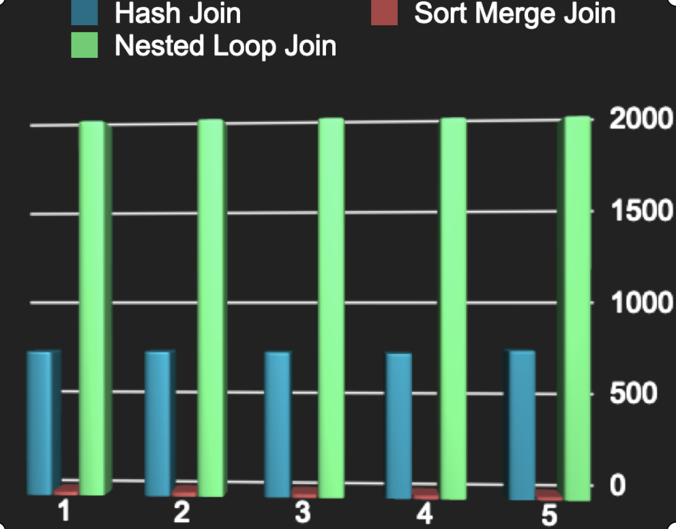
Results
Exp no | Hash Join | Sort Merge Join | Nested Loop Join
1 | 744.261 | 15.581 | 1943.514
2 | 745.843 | 17.656 | 1946.19
3 | 744.190 | 15.965 | 1946.495
4 | 739.282 | 15.581 | 1941.098
5 | 755.256 | 14.517 | 1942.297
Average | 745.664 | 15.86 | 1943.9188

Slide 25
Results
According to our expectations sort merge join executes the fastest and is used when we used the clustered attribute of both the tables as the join predicate
Hash Join is the next best when it comes to execution time and is used when we perform a join on two tables and the join predicate is an unclustered index
The worst in performance is the nested loop join and is used when we perform a join on two very large tables and the join predicate is a range query. Even though we have an unclustered index on the table we saw the query optimizer perform a nested loop join.

Slide 26
Conclusion
We have learned how just changing a single parameter can have an impact on performance. For example, a clustered index may take less time to fetch queries than an unclustered index but, again the reverse is possible too. Forcing the query optimizer to pick a plan than what it originally did sometimes enhanced the performance and it was interesting to analyze why the optimizer would have chosen a particular plan.
We understood the real world impacts of a clustered index vs a non-clustered index and why a good index always speeds up your execution time.
We understood multiple parameters that postgresql has and understood the practical benefits of tuning these parameters to get better results.

Slide 27
Conclusion
We would have loved to perform speedup experiments but we didn’t have that many processors at our disposal to perform speedup experiments.
With time what we have observed is that the performance of the single user systems has not changed drastically by enabling or disabling any parameter but even those slight differences would become big ones in a multiuser environment. And hence we understood why gaining the most optimal performance on a single user system is more beneficial as it would probably be an indicator to how the system would perform in a multi-user environment.

Slide 28


Slide 29
REFERENCES
https://www.postgresql.org/about/
https://community.microstrategy.com/s/article/How-to-increase-the-work-mem-setting-in-your-PostgreSQL-database?language=en_US
https://medium.com/we-build-state-of-the-art-software-creating/why-should-i-use-postgresql-as-database-in-my-startup-company-96de2fd375a9#:~:text=%E2%80%9CPostgreSQL%20comes%20with%20many%20features,source%2C%20PostgreSQL%20is%20highly%20extensible.

